Slide 1
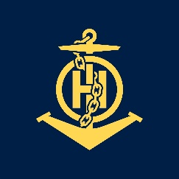
Mr. Nguyen Manh DUONG
IHO - NIPPON FOUNDATION
ALUMNI SEMINAR

Slide 2
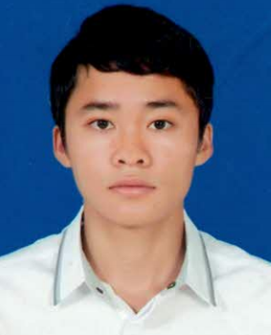
Self introduction
IHO - NIPPON FOUNDATION
ALUMNI SEMINAR
Name | Nguyen Manh DUONG
Alumni year | 2016
Country | Viet Nam
Organization | Vietnam Maritime Safety - North (VMS-North)
Position/Job title | Technical Officer at Maritime Safety Department
Current job description | 1. Management the status of Aids to Navigation on 05 access channels (including 53 marine buoys, 04 beacons) and 17 lighthouses; 2. Joining the inspection works of Nautical charts products, survey products and publications (List of Lights, Charts Catalogue, Quarterly and Annual Summary of Notices to Mariners) of Hydrographic Survey Division - North (HSD-North - one Division belongs to VMS-North) and inspect the updating of changes on Nautical charts products (Paper charts and ENCs); 3. Joining the creating and issuing works of Notices to Mariners.
Please put your photo here!

Slide 3
My career path and projects / Achievements
IHO - NIPPON FOUNDATION
ALUMNI SEMINAR
2008 - 2013: Studied at maritime safety faculty of Vietnam Maritime University to get maritime safety engineer in Haiphong city, Vietnam;
In May and October, 2011: completing the training courses of Applied Informatics in Civil Engineering: LAND DESKTOP and MATHCAD which are organized by Maritime Construction Consultant and Technology Development Center in Haiphong city, Vietnam;
10th November - 14th November, 2014: completing the EAHC Training Course on Technical Aspect of Maritime Boundaries, Baselines and Extended Continental Shelf which is organized in Jakarta, Indonesia;
9th August - 15th August, 2015: attending the technical visit to Hong Kong Hydrographic Office (HKHO) to get to know about the procedure of production and update Paper Charts and ENCs of HKHO;
23rd July - 13th August, 2016: attending the technical visit to Maritime and Port Authority of Singapore (MPA) to get to know about the procedure of production and update Paper Charts and ENCs of MPA;

Slide 4
My career path and projects / Achievements
IHO - NIPPON FOUNDATION
ALUMNI SEMINAR
5th September - 16th December, 2016: completing the CAT B training course recognized Hydrographic Data Processing and Marine Cartography course - sponsored by Nippon Foundation which is organized in the United Kingdom Hydrographic Office (UKHO) and is recognized as a member of the Japan Nippon Chart Project - Nippon Foundation Fellows - Japan Capacity Building Project;
21st July - 30th July, 2017: completing the training programme about using UAV for Establishment of Topography map which is organized at Hydrographic Survey Division-North by lecturers of Hanoi University of Mining and Geology in Haiphong city, Vietnam;
01st Ocotber - 05th October, 2018: completing the traning course on the IALA Risk Assessment using IWRAP MK2 which was held at Tokyo Denki University, Senju, Tokyo, Japan;
11th November 2017 - 30th July, 2019: completing the master course about charts, remote sensing and GIS at Hanoi University of Mining and Geology.

Slide 5
Lessons learned from CHART Course
IHO - NIPPON FOUNDATION
ALUMNI SEMINAR
After attending the training course in UKHO, I obtained a lot of precious knowledge:
Firstly, I understand pretty clearly about forms of Notices to Mariners, the difference between each type of NM, how to create a NMs, and update these information on our charts,...
Secondly, I feel quite confident when assess new data, new information that we received from other sources, how to make the decisions to leave or delete features on Nautical Charts, which features is necessary for mariners. In addition, regarding to ENCs, I enhance my ability in encoding features and then got a few errors after checking.

Slide 6
Lessons learned from CHART Course
IHO - NIPPON FOUNDATION
ALUMNI SEMINAR
Finally, this chart course is really a good chance for me to see many good friends and many best trainers after the course. I also thanks to Mr.Derek, Ms.Lucy a lot because their help when I have any question.

Slide 7
Suggestion for the future
IHO - NIPPON FOUNDATION
ALUMNI SEMINAR
I would like to have some suggestion for IHO in the future as follows:
1. Keep maintaining the Nautical Chart training course for nations are not IHO member, newly IHO member;
2. Nippon Foundation should fund for hydrographic survey;
3. Selecting right person of right organization;
4. Organizing many seminars to exchange experiences about nautical charts between IHO members and especially alumni.

Slide 8
HSD - NORTH
THANKS FOR LISTENING!

